Slide 1

CREATION OF A NEW DASHBOARD FOR MANAGEMENT TEAM

Slide 2




INTRODUCTION
OBJECTIVE
Creating a multi-services dashboard
FIELDS OF ANALYSIS
Sales, Finance, Logistics, Human Resources, CRM (bonus)
EXPECTED DELIVRABLE
A tool that can be refreshed at any time to access to the latest information to manage the company
TOOLS WE USED
- A SQL database listing products, employees, orders, payments…
- MySQL to request this database and cross information
- Microsoft PowerBI as a data visualization tool

Slide 3
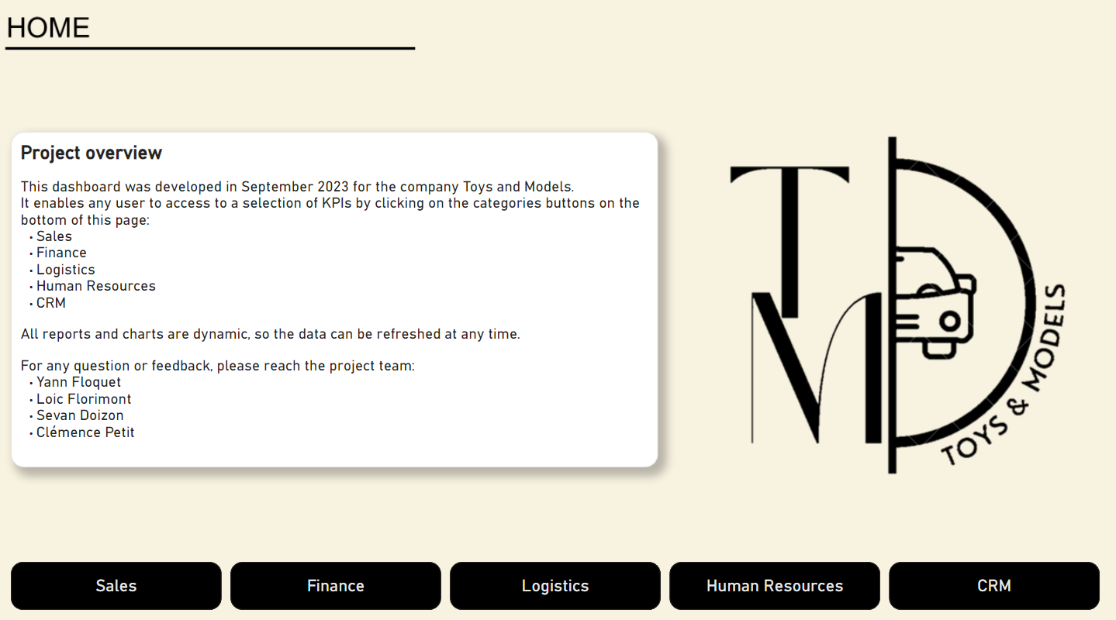
DEMONSTRATION OF THE DASHBOARD

Slide 4
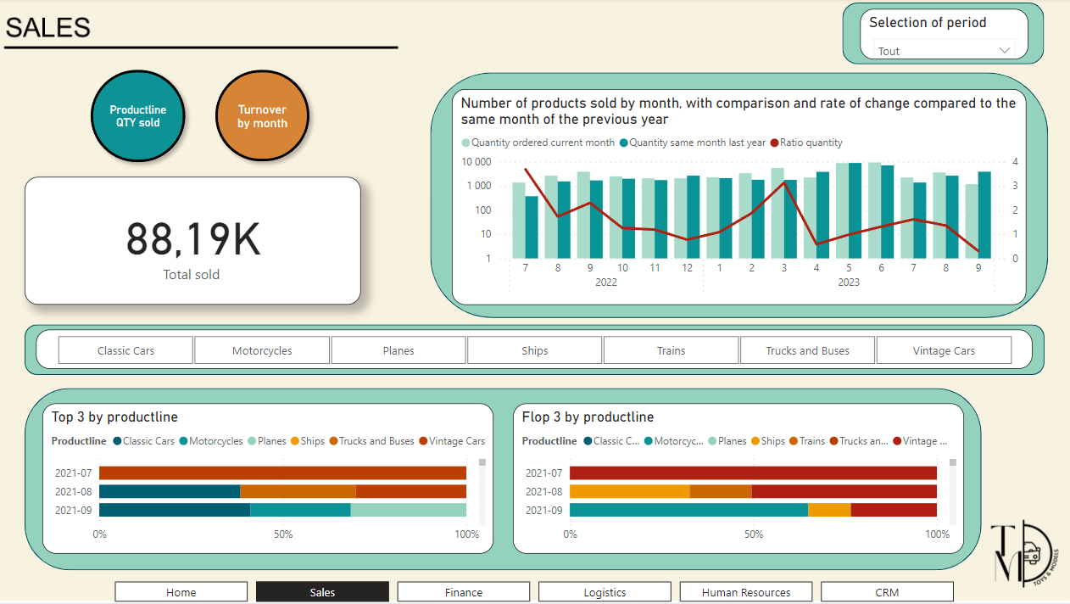
DEMONSTRATION OF THE DASHBOARD

Slide 5
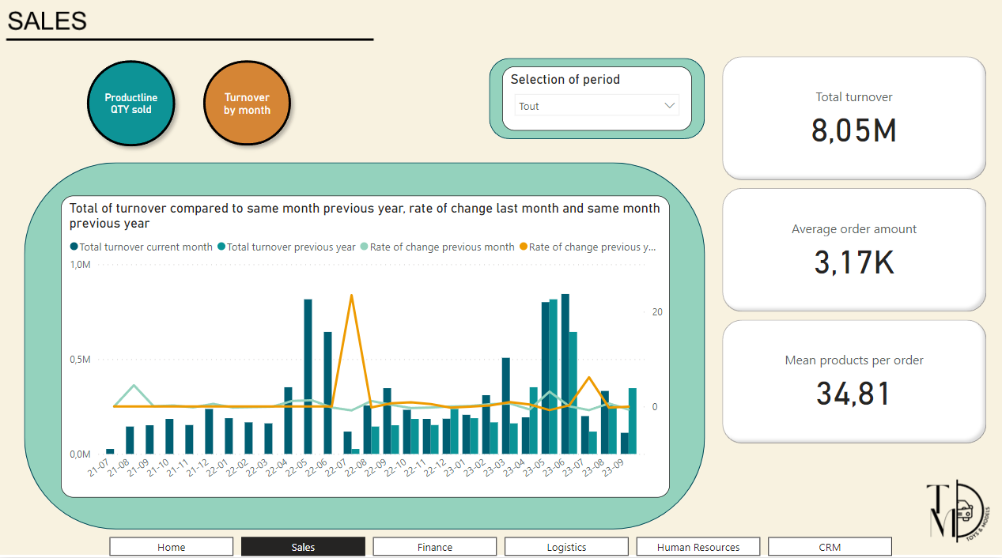
DEMONSTRATION OF THE DASHBOARD

Slide 6
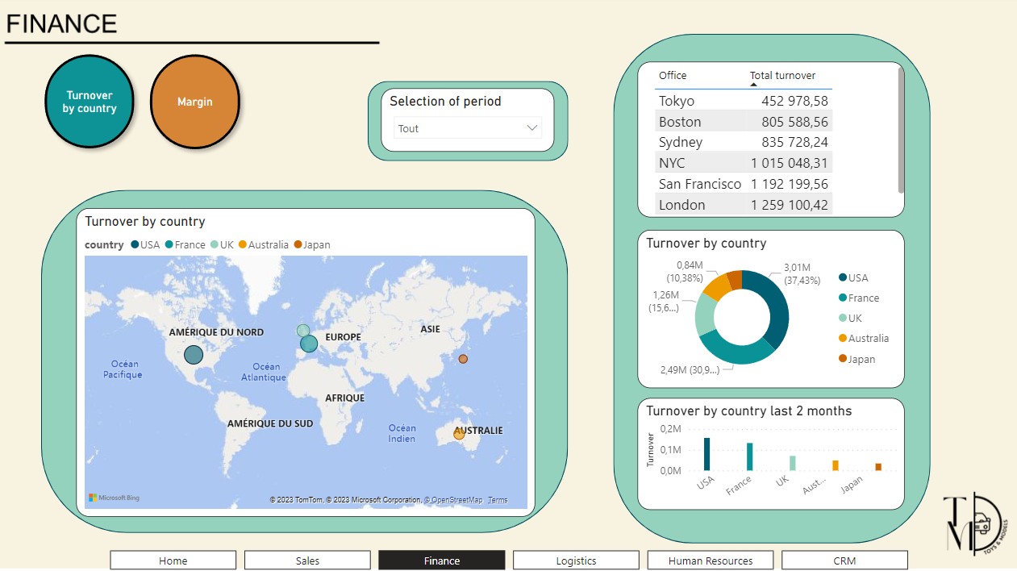
DEMONSTRATION OF THE DASHBOARD

Slide 7
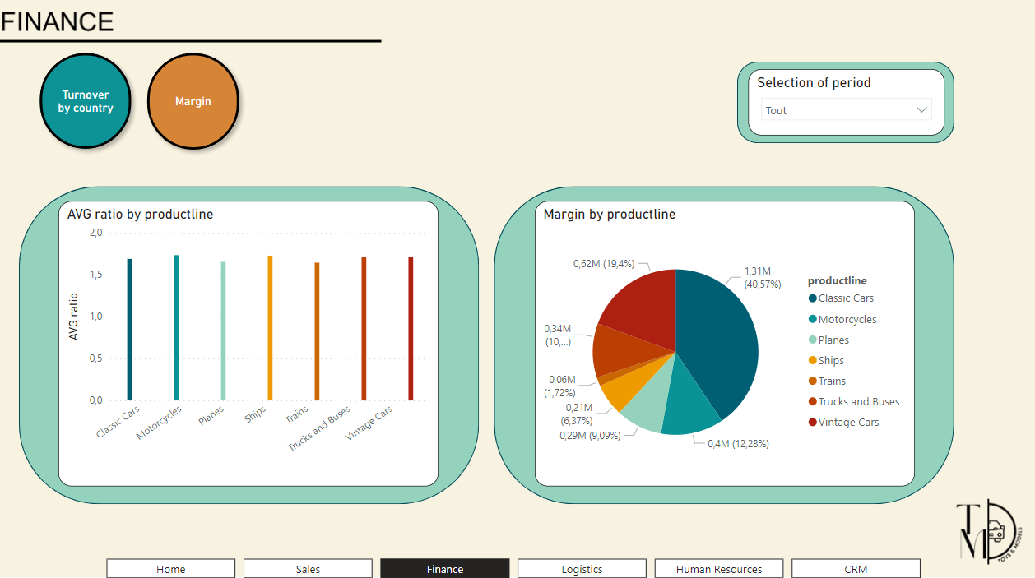
DEMONSTRATION OF THE DASHBOARD

Slide 8
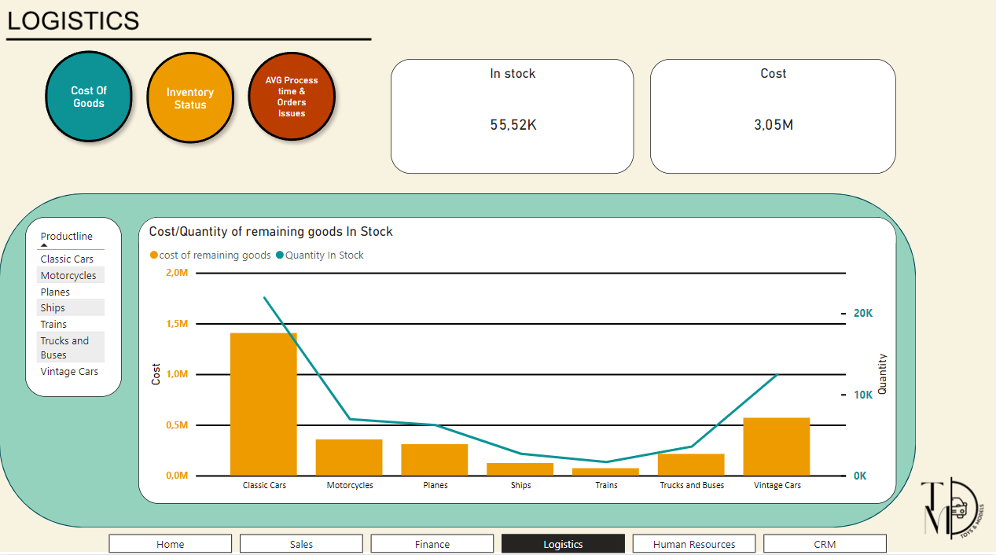
DEMONSTRATION OF THE DASHBOARD

Slide 9
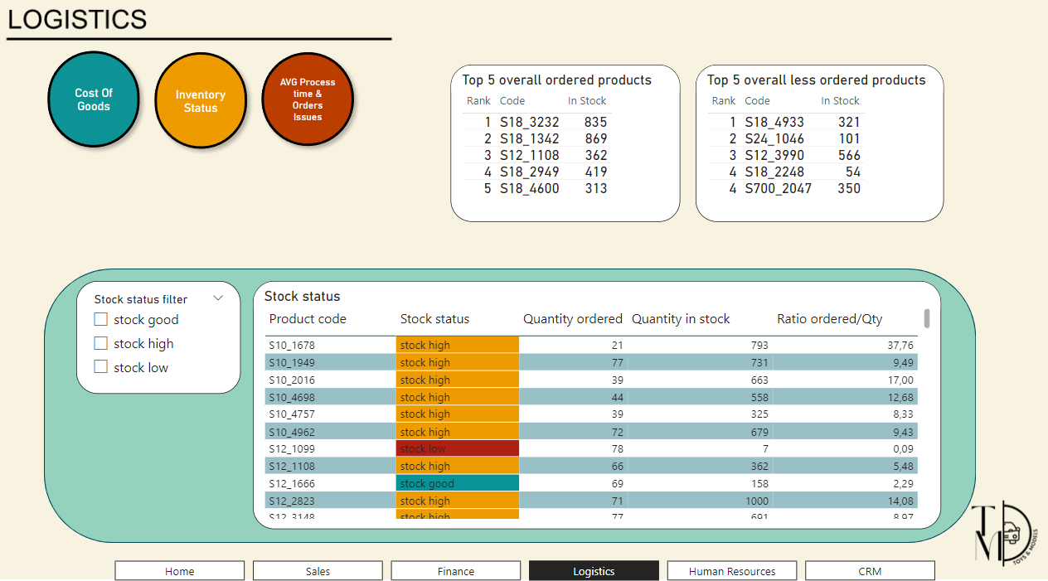
DEMONSTRATION OF THE DASHBOARD

Slide 10
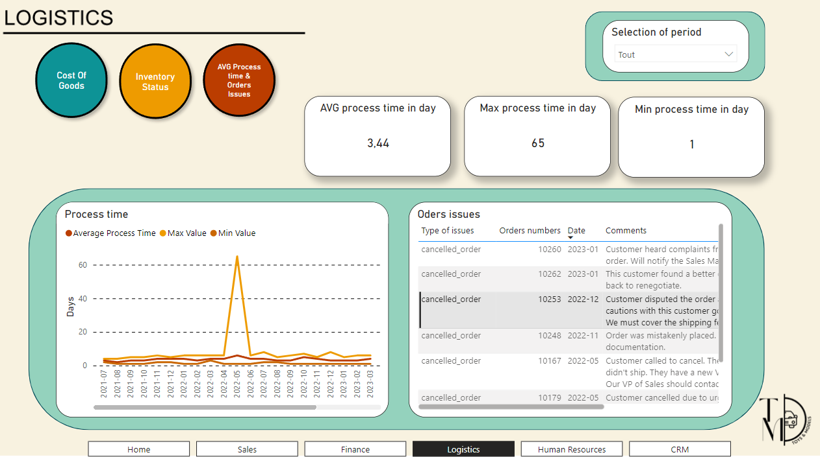
DEMONSTRATION OF THE DASHBOARD

Slide 11
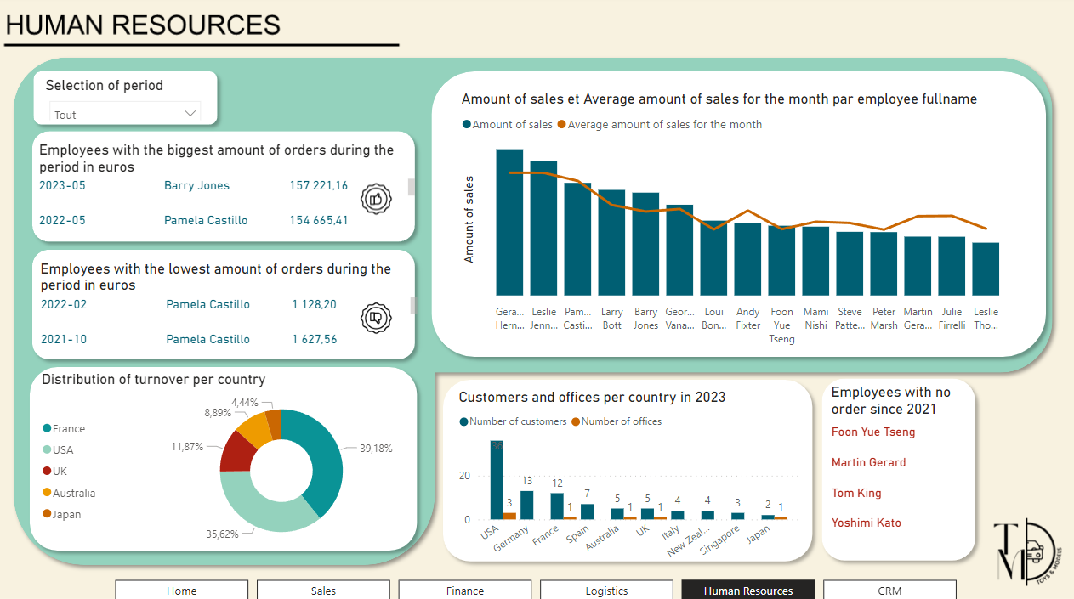
DEMONSTRATION OF THE DASHBOARD

Slide 12
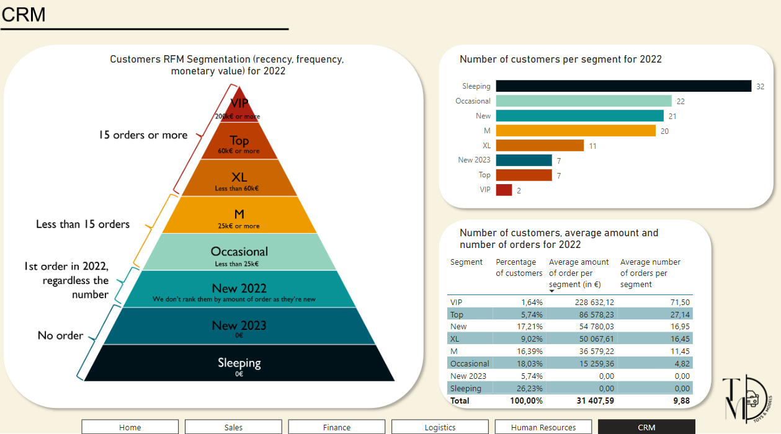
DEMONSTRATION OF THE DASHBOARD

Slide 13
SALES CONCLUSIONS AND RECOMMENDATIONS
CONCLUSIONS AND OBSERVATIONS | RECOMMENDATIONS
The most ordered products are in the "Classic cars" and "Vintage cars" productlines, followed by "Motorcycles", "Planes" and "Trucks and buses". The least ordered belong to the "Ships" and "Trains" categories. | We can continue to expand the range of the most popular productlines to maintain our solid base. We can also launch marketing operations on the least-ordered productlines in order to relaunch them, and think about eventually discontinuing them if things don't improve.
We notice that the months with the best sales are May and June, and the worst in July. However, our sales have risen steadily from year to year in July. | We need to continue our efforts in July to improve our sales to an average level. We can also launch bigger marketing operations before the end-of-year holidays to improve our end-of-year sales.
The average basket has remained constant over the period, but we need to improve if we are to increase sales. | We can achieve this by following the above recommendations, increasing our sales volumes, and expanding or reducing the most or least successful ranges.

Slide 14
FINANCE CONCLUSIONS AND RECOMMENDATIONS
CONCLUSIONS AND OBSERVATIONS | RECOMMENDATIONS
The Asian market is considerably less advanced in comparison to other markets. The cause could be that our products don’t align very well with Japanese culture and expectations. | Within the range of cars, there isn't any Asian brand. We could add new asian car models that would resonate more with this population.
The train falls under the least profitable category, and furthermore, it sells much less than the other products. | We could find another supplier for this category and increase our margin and sells.
There is a lack of data concerning employee payroll costs, rent, or company-owned assets. This is mandatory to accurately assess a company's financial health and plan for the long term. | Please furnish us with such information for a more comprehensive evaluation of the company.

Slide 15
LOGISTICS CONCLSIONS AND RECOMMENDATIONS
CONCLUSIONS AND OBSERVATIONS | RECOMMENDATIONS
Cost of goods: Our stocks accurately reflect the distribution of ordered products, allowing us to easily meet our customers' needs. | We must follow the sales trend to make sure they match well with average ordered quantity per period.
Average processing time (order date to shipping date): Over the entire exercise, we observe an average processing time of 4 days. | We can benchmark our competitors to know if our positioning is answering our customers’ expectations.
Order issues: The main issue encountered stems from canceled orders. | We need to focus on the reasons of cancelations to reduce their number in the future.
Inventory status: We have a large amount of stock in proportion to the number of orders. | Note: It would be important to review the inventory based on sales priorities.

Slide 16
HR CONCLUSIONS AND RECOMMENDATIONS
CONCLUSIONS AND OBSERVATIONS | RECOMMENDATIONS
Each month, we can also easily identify the Sales Rep who are under the average amount of sales and see if those performances are recurrent of isolated. | - Reward the best employees with a stay in a palace or a chef dinner at the restaurant for example. - Organize a 1-1 meeting with the employees who are underperforming to understand their difficulties.
4 Sales Rep employees have no order since 2021. | - Speak with HR team to know if the employees database is up to date.
France and US are often the best countries in terms of turnover. | - Organize a meeting to share best-practices between countries
We have a lot of customers in Germany and Spain, whereas we don’t have any office in this country. | - Make a deep analysis to know if it could be interesting to open local offices.

Slide 17
CRM CONCLUSIONS AND RECOMMENDATIONS
CONCLUSIONS AND OBSERVATIONS | RECOMMENDATIONS
The biggest part of our database is composed of sleeping customers. | - Run a reactivation marketing action to wake them up. Example: a special discount or gift if they order again.
The Top and VIP represents only 8% of our database but make a big part of our turnover. | - Make sure we pamper them. Example: the possibility for them to order some novelties before other customers, invitation to a special event in their country (Roland Garros, Olympic Games…).
The 2022 New customers seem to be good customers, they have a similar behavior than XL customers. | - Ensure they’ll become loyal by offering them some advantages for instance. Example: a case of Champagne bottles delivered at the office for Holiday Season.

Slide 18


CONCLUSION
DIFFICULTIES ENCOUNTERED
- Lack of informations in some fields (ex. Finance, HR)
WHAT WE COULD HAVE DONE BETTER
- Better understanding our client’s needs thanks to regular meetings

